Slide 1
NES Project – Task 6 Game Logic
Daniel José Febles Bustillo

Slide 2
Video Objectives
Display sprite text to inform player
Talk about the actual game mechanics
Showcase the timer and its pseudo-BCD system
Discuss how winning and losing works
Highlight the pause button as a bonus
Shows the results of the process

Slide 3
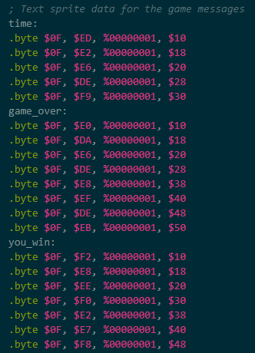
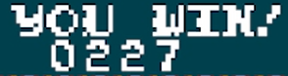
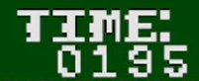

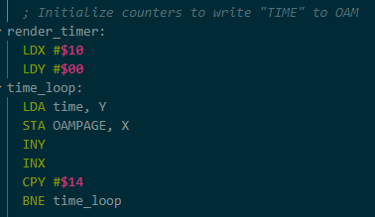
Text Display
The last task is very simple to understand, so there won’t be much discussion over code
Need to display text to the player
Writing it to nametables isn’t a good idea since it can be costly, and the scrolling can push it off screen
Screen interrupts can make it so that certain parts of the nametable don’t scroll, but it’s better to keep things simple
Use tables and looped sprite drawing routines to display text
Helps player receive important information

Slide 4
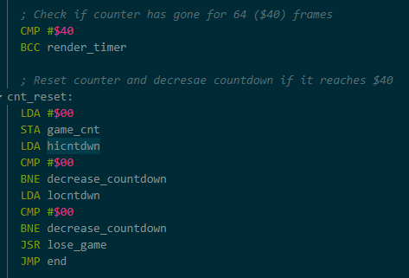
Timer Display
Display uses a pseudo-BCD system
NES technically has the hardware for BCD, but it’s soldered off due to not having the rights to use it
BCD isn’t hard to replicate, though, and can be made on the fly, though it can get costly when doing arithmetic
The timer is displayed in “seconds”
It moves down one tick every 64 frames with its own internal clock (this is an arbitrary and personal choice; it can be faster or slower)
Once it reaches zero, it’s game over
The first stage has 200 seconds, the second has 100

Slide 5
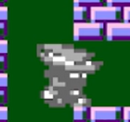
Game Over and Victory
Keep game over screen simple
Player gets a palette change and is locked out of movement, becoming “petrified”
Only option at this point is to reset the game
When player reaches the end of the first stage, we transition into the second stage
This is made from repurposed code of the stage switching screen
At the end of the second stage, player is told that they won and are given their high score
The high score is a combination of both their times

Slide 6
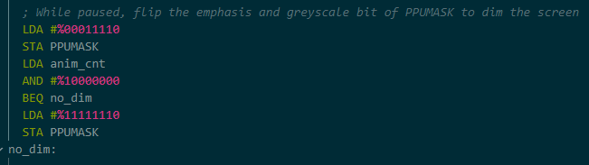
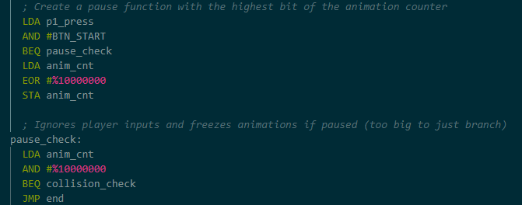
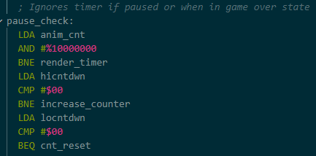
Pausing the Timer
Expand upon the pause button features that was hinted at in task 4
Give feedback by dimming the screen with the PPUMASK’s emphasis bits
Freeze player movement and animation when pause happens
Use the animation clock to do this, since player movement is tied to it anyway
Have the animation bit also affect the counter so that the player can take a break from the game without starting over

Slide 7
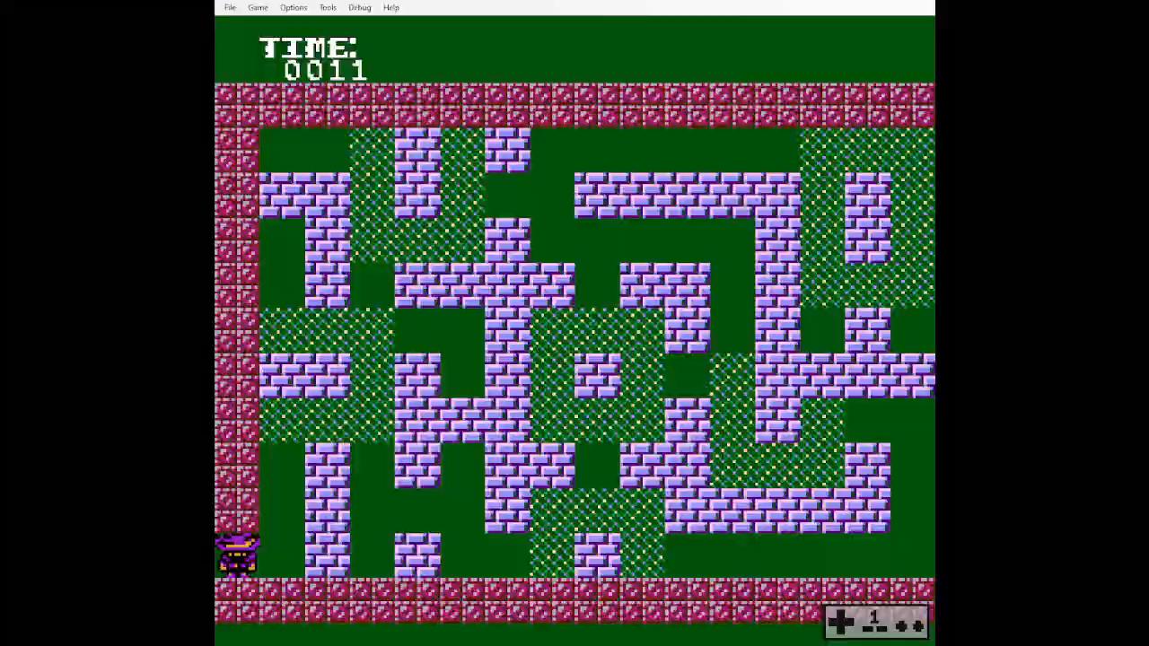
Final Result

Slide 8
Thank you for your attention

